Slide 1

Meta Kaggle
Group 4
Aakriti Lnu
Gokula Naveen
Muhammad Raees
Prajjwal Mehta
CSCI 620

Slide 2
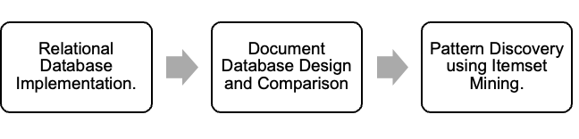
Project Overview
This project explores the Meta Kaggle dataset
View of the Kaggle community and platform activities
Users, Competitions, Datasets, and interactions between them
Executed in three phases

Slide 3
Dataset Overview
Dataset: Meta Kaggle
Kaggle’s platform activities
Data is provided in CSV files
https://www.kaggle.com/datasets/kaggle/meta-kaggle
Size: Large (above billion)
Subset (127 million) taken to make the project manageable

Slide 4
Dataset Overview
User Engagement
User growth, competition participation, and submission trends
Competitions
Competitions hosted, participants, and how rewards correlate with participation levels
Submissions
Evaluate their timing and correlate them with user or team performance
Datasets
Trends in dataset creation and usage to understand which datasets are most valuable to the community
Other Insights
e.g., scores, algorithms, badges

Slide 5
Data Insights

Slide 6
Users
Username (Display Name)
Registration Date
Organizations
Join Date
Followers
Following Date
Achievements
Achievement Date
Points
Rankings
Badges (Gold, Silver, Bronze)

Slide 7
Competitions and Datasets
Competitions
Tag
Forum
Creation and Deadline
Prizes
Teams
Submissions
Evaluation
Datasets
Tag
Forum
User
Creation and Last Activity
Views
Download
Votes

Slide 8
Teams, Submission, Tags, and Forums
Teams
Name
Team Leader
Competition
Submission
Submitter
Date
Public and Private Score
Tags
Tag Name
Parent Tag
Forums
Forum Name
Parent Forum

Slide 9
RELATIONAL MODEL
Phase I

Slide 10
Main Entities
Users
Achievements
Forums
Teams
Competitions
Submissions
Tags
Datasets
Organizations

Slide 11
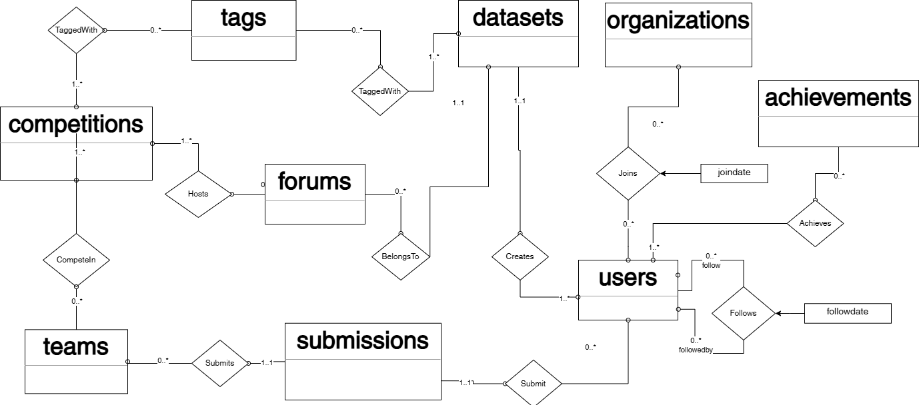
ERD

Slide 12
Relations
Relation | Description
Users | Kaggle users, including their performance tiers and registration data
User Achievements | Achievements of Kaggle users, including rankings, points, and medal counts
User Followers | Tracks who follows whom
Organizations | Organizations on Kaggle
User Organizations | Links users with their affiliated organizations
Teams | Teams for competitions, such as membership and medals won
Submissions | Submissions to competitions, including scores and submission dates
Datasets | Dataset information, including total downloads, views, and votes
Competitions | Competitions, including deadlines, rewards, and evaluation methods
Tags | Tags applied to competitions, datasets, kernels, and forums
Dataset Tags | Datasets with tags for categorization purposes
Competition Tags | Competitions with tags for categorization purposes
Forums | Forum posts, including title and parent relationships

Slide 13
Challenges
Size of the data
Basic analysis – data types, size (or length), completeness check
Basic filtering – removing some empty columns
Chunked insertion – to avoid memory over-runs
Referential constraints
Enforced some constraints by checking inserted values
Ignored the type mis-match and missing cases

Slide 14
DOCUMENT MODEL
Phase II

Slide 15
Document Model
Users
Organizations
Followers
Achievements
Datasets
Tags, Forums
Competitions
Tags, Forums
Teams
Submissions
Organizations
Tags
Forums

Slide 16
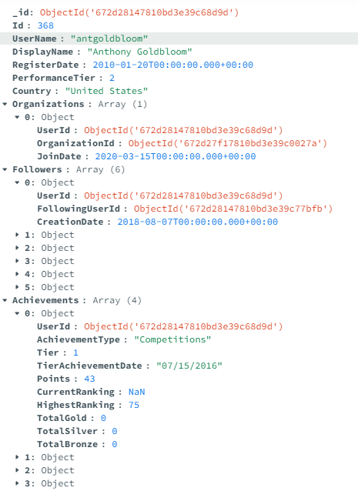
Collection Users

Slide 17
Issues
Referential Constraint Mapping
Maping IDs to Object IDs
2.5X Slower Insertion
Find and Insert (bulk insertion)
Slower Query Operations
Nested Structure

Slide 18
DATA QUERYING
Phase II

Slide 19
Querying Relational Model
Our dataset was already normalized
Querying provided interesting insights
Indexed key columns to improve query performance

Slide 20
Querying Relational Model
Top Competition Tags by User Medals
Tables Used: CompetitionTags, Tags, Competitions, UserAchievements
Top Users by Followers and Achievements
Tables Used : UserFollowers, Users, UserAchievments
User Achievements and Dataset Creation
Tables Used : Users, UserAchievements, Submissions, CompetitionTags, Tags, Datasets
Competition Tags with Highest Engagement
Tables Used : CompetitionTags, Tags, Competitions, Submissions
Dataset Engagement by High-Achieving Users
Tables Used : UserAchievements, Users, Datasets, DatasetTags, Tags

Slide 21
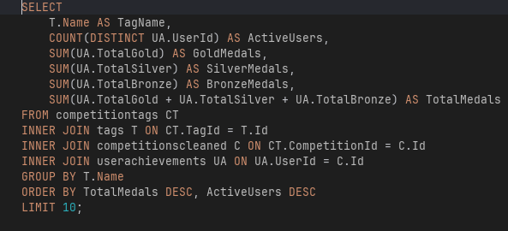
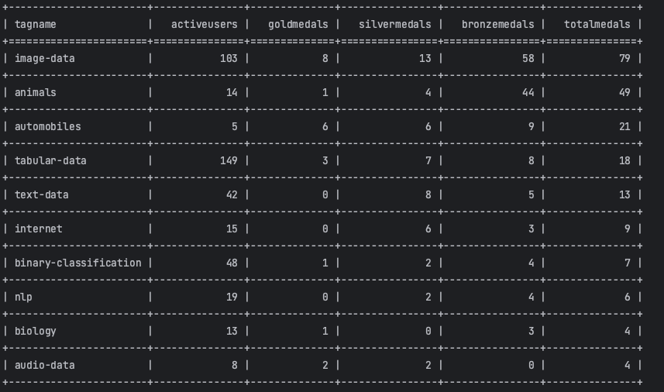
Query 1
Top Competition Tags by User Medals

Slide 22
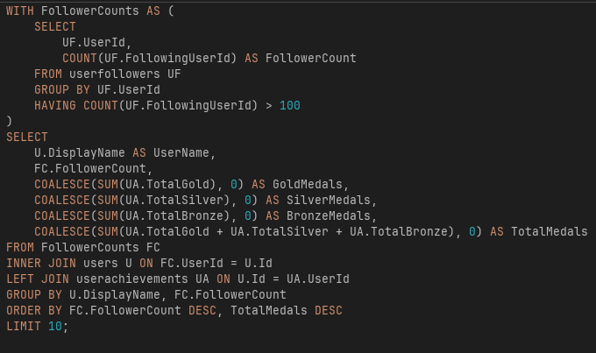
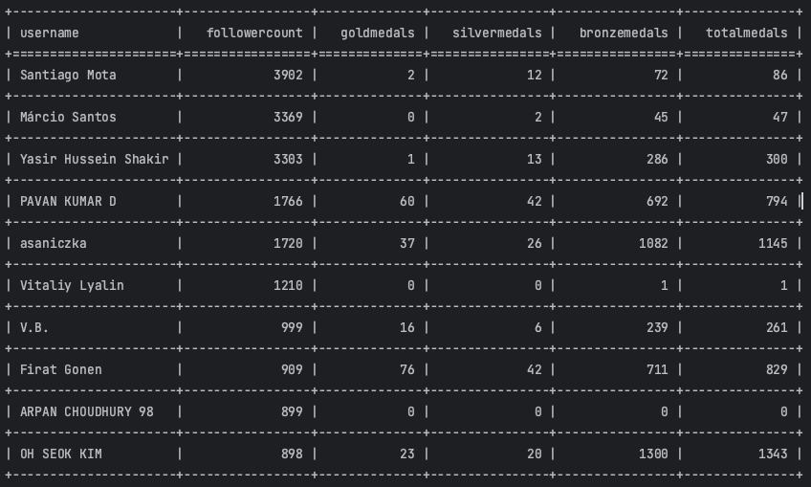
Query 2
Top Users by Followers and Achievements

Slide 23
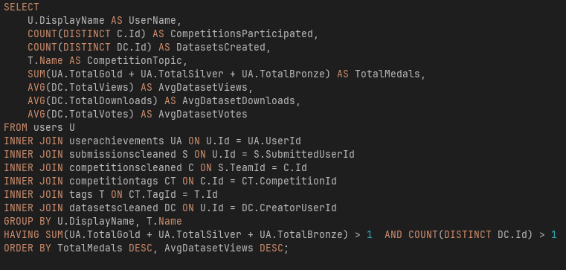
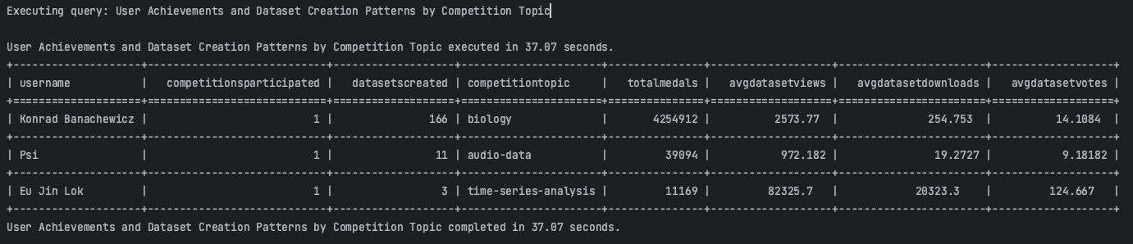
Query 3
User Achievements and Dataset Creation Patterns by Competition Topic.

Slide 24
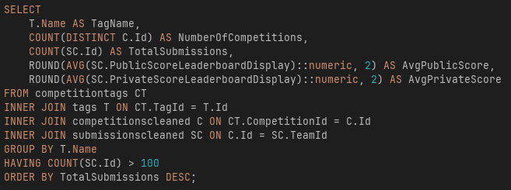
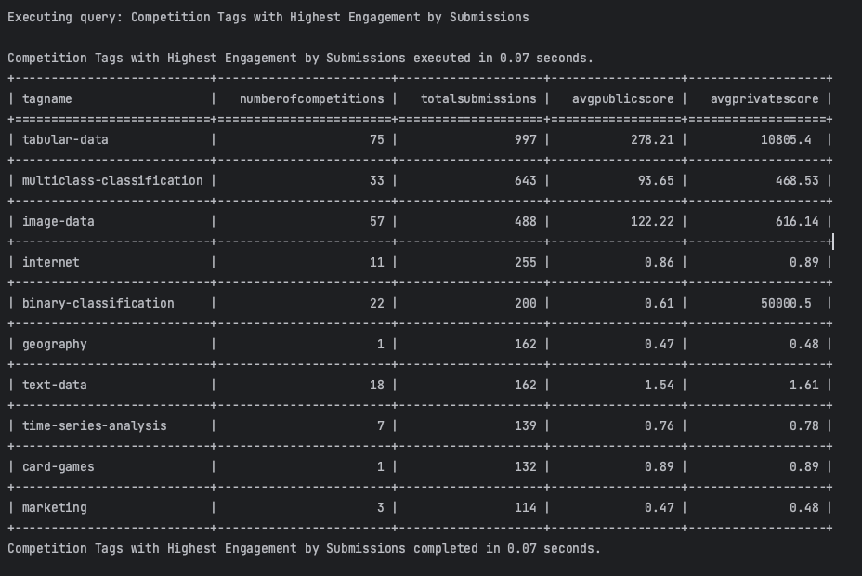
Query 4
Competition Tags with Highest Engagement by Submissions.

Slide 25
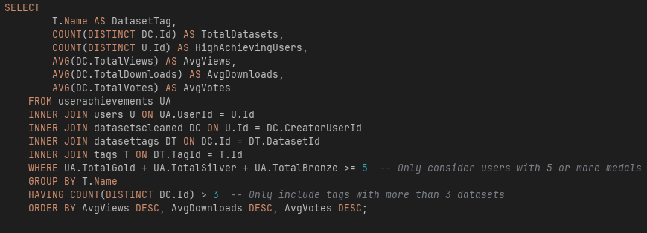
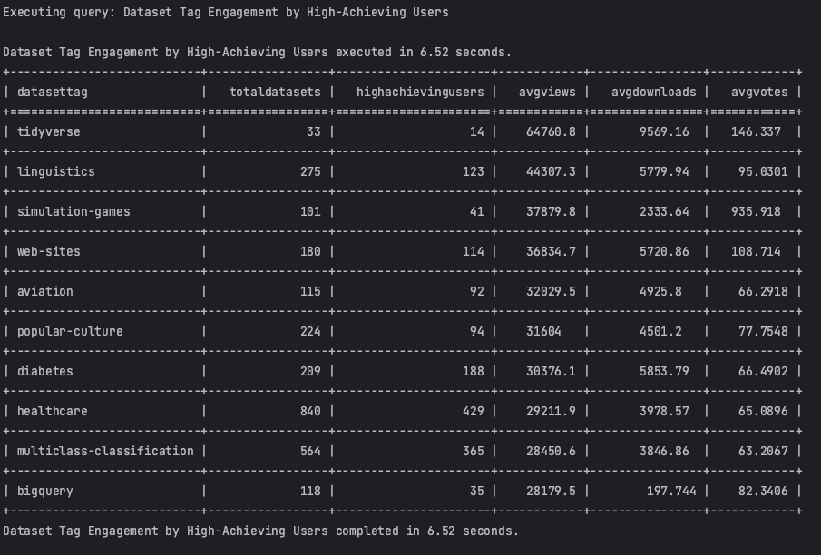
Query 5
Dataset Tag Engagement by High-Achieving Users.

Slide 26
DATA CLEANING
Phase III

Slide 27
Data Cleaning
Duplicate Check
No duplicate data found
Missing Values
Empty
NaN
Incorrect Format (Data types)
Numbers
Dates

Slide 28
Missing Values
Display Name (314/20M)
Solved by replacing with username
Country (19M/20M), Rankings
Cannot do much about it
Team Name (25K/7M),
Removed from the dataset
Some missing values ignored
tag and organization descriptions
Scores, Rankings

Slide 29
Referential Validity
We enforce all referential constraints
Removed missing references: Team Leaders, Submitter (users), Parent Tags
We ensure all data type (and format) constraints
SubmittedUserId – float to integer
TeamLeaderId – float to integer
SubmissionDate – text to date (ignoring empty)
Some fields had no solutions
Forum -> Parent Forum

Slide 30
Data Cleaning
Attribute | Table | Cleaning Action | Results | Insights
ParentTagId | Tags | Converted FLOAT to INTEGER and removed invalid references | 10 nulls processed; 3 invalid references removed | Ensured valid self-references and consistent data types for hierarchical tags.
Country | Users | Retained null values. | 19,034,320 nulls kept out of 20,485,253 records. | Optional field; does not impact core analysis.
FollowingUserId | UserFollowers | Removed records with invalid references. | 29,375 records removed out of 1,555,414 total. | Ensured valid relationships between followers and followed users.
CreatorUserId | Datasets | Removed invalid references. | 9,091 records removed out of 397,793 total. | Ensured dataset creators are valid and linked to Users table.
TeamLeaderId | Teams | Converted FLOAT to INTEGER and removed invalid references. | 26,306 nulls removed out of 7,675,480 records. | Ensured valid leader references while retaining most data.
HighestRanking | UserAchievements | Retained null values. | 81,417,236 nulls kept out of 81,940,708 records. | High null count; assumed default for users without rankings.

Slide 31
ITEM SET MINING
Phase III

Slide 32
Mining
Implemented Apriori algorithm for 3 distinct analyses
Competition Tags (440 competitions)
Dataset Tags (171,990 datasets)
User Organizations (2,066 relationships)
Transaction Definition
Each entity (competition/dataset/user) = 1 transaction
Items = associated tags or organizations

Slide 33
Key Association Rules
Competition Tags
Beginner → Tabular Data (conf=1.0)
Banking → Tabular Data (conf=0.91)
Dataset Tags
Data Cleaning + Marketing Analytics (lift=16.75)
Business + Finance (lift=18.56)
Organizations
IIT KHARAGPUR ↔ SPARK4AI (conf=1.0, lift=39.73)

Slide 34
Key Implications
Platform Insights
Tabular data dominates competition (40%)
Pre-trained models common in datasets (14.2%)
Strong educational institution partnerships
Practical Applications
Tag recommendation systems
Competition difficulty prediction
Organizational partnership opportunities

Slide 35
Conclusions
Data is Highly Normalized
Relational model is an effective choice
Growing collection size increases query time substantially
Ensuring referential constraints is difficult without cleaning
Yet, most of the data is clean and valid
User engagement with datasets and competitions shows interesting patterns across the Kaggle platform

Slide 36
Questions
Thank You

